Slide 1

ENHANCING PRODUCT AUTHENTICATION AND COMBATING COUNTERFEITING IN RETAIL USING BLOCKCHAIN TECHNOLOGY
BY
NICHOLAS CHINEDU ANI
OBINNA MAXWELL
ABDULLAHI MUHAMMAD KUDU
Lagos, Nigeria

Slide 2
©2023 NICHOLAS CHINEDU ANI
A CAPSTONE PROJECT
SUBMITTED TO THE FACULTY OF BLOCKCHAIN STUDIES AND ARTIFICIAL INTELLIGENCE
AT THE ALTHASH UNIVERSITY
IN PARTIAL FULFILMENT FOR THE REQUIREMENTS FOR THE COLLEGIATE OF SCIENCE IN BLOCKCHAIN STUDIES DIPLOMA
CHICAGO, ILLINOIS

Slide 3
ABSTRACT
Counterfeiting of products poses a significant global challenge in the retail industry, leading to loss in revenue, compromised brand reputation, and potential harm to consumers. This research aims to explores the application of block chain technology to enhance product authentication and combat counterfeiting in retail operations. By leveraging the unique properties of block chain, such as immutability, transparency, and decentralized consensus, this study investigates how retailers can implement robust systems to verify product authenticity, trace the origin and supply chain history, and protect consumers from counterfeit goods. The research examines various block chain-based anti-counterfeiting measures, including the use of cryptography signatures, smart contracts, and distributed ledger technology, to establish secure and tamper-proof product verification processes. The potential impact of block chain-based solutions on enhancing trust, consumer confidence, and brand reputation in the retail industry is analyzed. Through a combination of theoretical analysis and practical case studies, this research aims to provide valuable insights into the implementation and effectiveness of block chain technology in combating counterfeiting and improving product authentication in the retail sector.

Slide 4
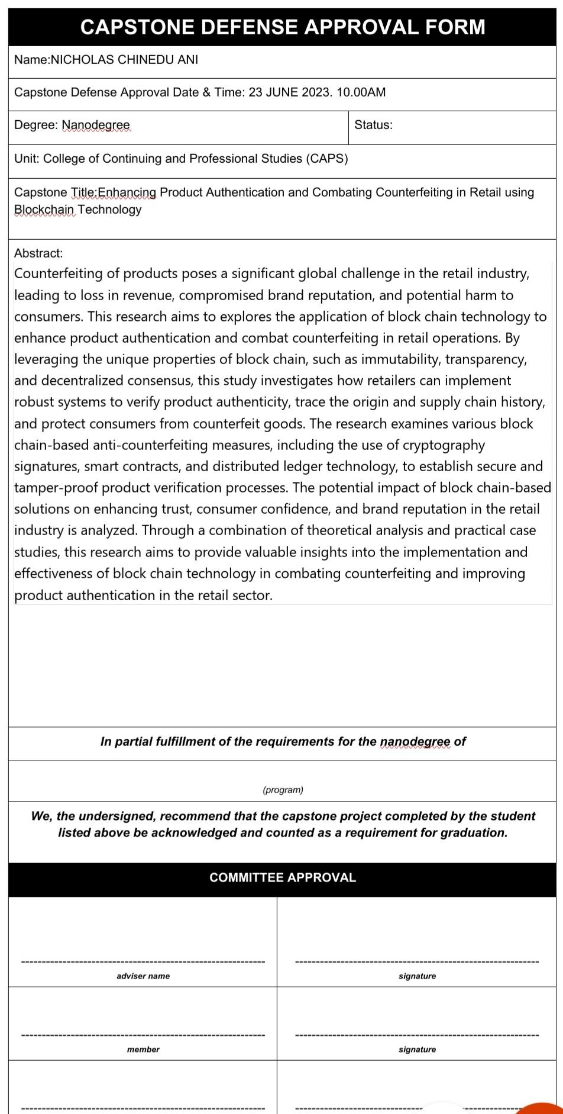
Capstone Defense Approval Form

Slide 5
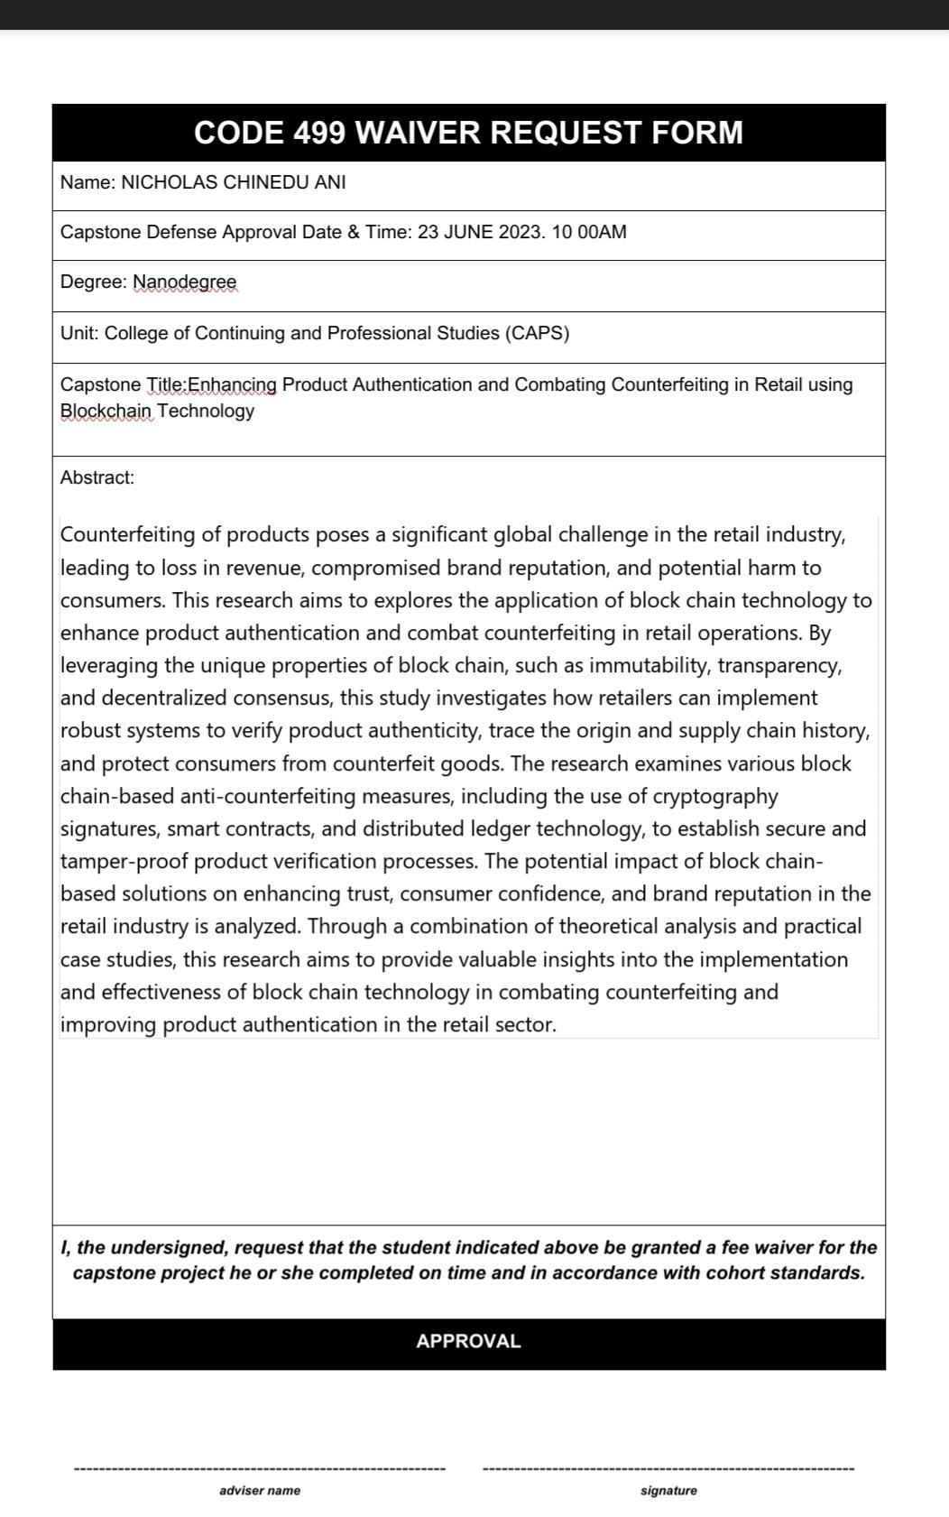
CODE 499 Waiver Request Form

Slide 6
Introduction
Counterfeiting and the sale of counterfeit products is a big global challenge in the retail industry, posing significant problem for businesses, consumers, and governments. Counterfeit products does not only harm the reputation and financial statues of legitimate brands but also jeopardize consumer safety and undermine trust in the marketplace. To combat this escalating problem, innovative solutions are required to enhance product authentication and ensure the integrity of supply chains.
One such technology that has emerged as a potential game-changer is blockchain. Originally introduced as the underlying technology behind cryptocurrencies like Bitcoin, blockchain has evolved into a versatile tool with a wide range of applications. Its decentralized, transparent, and immutable nature makes it an ideal candidate for combating counterfeiting in the retail sector.
This research aims to explore how blockchain technology can be leveraged to enhance product authentication and combat counterfeiting in the retail industry. By harnessing the power of blockchain, retailers can establish a robust

Slide 7
and trustworthy system that verifies the authenticity of products throughout the supply chain, from manufacturer to end-consumer.
The research will look into how the fundamental principles of blockchain can be used in product authentication. It will also investigate various mechanisms and protocols employed within blockchain systems to validate and record product information securely. By exploring real-world case studies and industry initiatives.
Furthermore, this study will assess the potential benefits and limitations of implementing blockchain-based solutions for product authentication in retail. It will consider factors such as scalability, cost-effectiveness, user adoption, and regulatory considerations to provide a comprehensive analysis of the technology's feasibility and applicability.
The findings of this research will not only contribute to the existing body of knowledge surrounding blockchain technology but also provide valuable insights for retailers, manufacturers, and policymakers seeking effective strategies to combat counterfeiting. By identifying the opportunities and challenges associated with the adoption of blockchain.

Slide 8
Problem Statement:
Counterfeiting and the sale of counterfeit products have emerged as significant challenges in the retail industry, threatening brand reputation, consumer safety, and trust in the marketplace. The existing methods of product authentication and supply chain transparency have proven inadequate in effectively combating counterfeiting. As a result, there is an urgent need to develop innovative solutions that can enhance product authentication and mitigate the risks associated with counterfeit products. This research aims to address this problem by investigating the potential of blockchain technology as a robust and secure tool for enhancing product authentication and combating counterfeiting in the retail sector.

Slide 9
Solution to the Problem
To address the challenges posed by counterfeiting in the retail industry, the implementation of blockchain technology offers a promising solution. By leveraging the unique features of blockchain, a decentralized and transparent system can be established to enhance product authentication and combat counterfeiting effectively.
The key components of this solution include:
Blockchain-based Product Traceability: Implementing blockchain technology allows for the creation of a tamper-proof and transparent ledger that records every transaction and movement of a product throughout the supply chain. Each product can be assigned a unique identifier, such as a digital token or barcode, which is recorded on the blockchain. This immutable record enables retailers, manufacturers, and consumers to trace the origin and journey of a product, ensuring its authenticity and eliminating the risk of counterfeit items entering the market undetected.

Slide 10
Smart Contracts for Authentication: Smart contracts, self-executing agreements built on the blockchain, can be utilized to automate the authentication process. These contracts can contain predefined conditions and rules that verify the authenticity of a product at each stage of the supply chain. For instance, when a product moves from the manufacturer to a distributor, the smart contract can automatically validate the product's authenticity based on predefined criteria, such as matching the product's unique identifier with the information stored on the blockchain. Any discrepancies or attempts to introduce counterfeit products can trigger immediate alerts, allowing for swift actions to be taken.

Slide 11
Consumer Engagement and Verification: Blockchain technology enables consumers to actively participate in the authentication process. By using mobile applications or online platforms, consumers can scan product identifiers and access the corresponding blockchain records. This provides them with real-time information about the product's authenticity, including its manufacturing details, certifications, and previous ownership history. Empowering consumers with this information fosters trust and allows them to make informed purchasing decisions, avoiding counterfeit products and supporting legitimate brands.

Slide 12
Mission ,Vision, Goals and Objectives
Mission:
To revolutionize the retail industry by providing innovative blockchain-based solutions that enhance product authentication, combat counterfeiting, and foster consumer trust.
Vision:
To create a global ecosystem where counterfeit products are eradicated, consumer safety is prioritized, and legitimate brands thrive through the power of blockchain technology.

Slide 13
To achieve our goals, we have identified the following objectives:
Develop and implement a robust blockchain-based product authentication platform:
Build a secure and scalable blockchain infrastructure that can handle the authentication needs of various retailers and manufacturers. This can be archive by Collaborating with blockchain experts and developers to design a decentralized application or online platform that ensures the integrity of supply chains and verifies product authenticity.

Slide 14
Establish strategic partnerships and industry collaborations:
Form alliances with key stakeholders, including retailers, manufacturers, industry associations, and regulatory bodies.Engage in partnerships to standardize authentication protocols, promote interoperability, and foster industry-wide adoption of blockchain-based solutions for counterfeiting prevention.

Slide 15
Educate and empower consumers:
Create awareness among consumers about the risks of counterfeit products and the benefits of blockchain-based authentication through developing user-friendly mobile applications called Authentico and online platforms that allow consumers to easily verify product authenticity using blockchain technology. Conduct educational campaigns to inform consumers about the importance of purchasing genuine products and the role they play in combating counterfeiting.

Slide 16
Continuously innovate and improve:
Stay at the forefront of technological advancements and continuously enhance the capabilities of the blockchain-based product authentication platform. Investing in research and development to explore emerging technologies, such as artificial intelligence and machine learning, to strengthen counterfeit detection mechanisms and improve the overall efficiency and accuracy of product authentication.

Slide 17
Token Name
The token name for the proposed research is Authentico (AUTH). The reason for choosing this name is because the name conveys the essence of product authentication and emphasizes the authenticity that the token and the research aim to achieve.

Slide 18
Token Ticker
AUTH
We have decided to use this token ticker {AUTH} in presenting our group capstone project,. The acronym stands for "Authentico". Authentico is a Dapp mobile application that can be used to verify product authenticity.

Slide 19
Token Maximum Supply:
The a mximum supply of AUTH is 250, 000, 000, 000 AUTH we decided to have this amouth to enable us meet
Our intended global audience. The project's goal is to create a platform to check product authentencity and combat counterfeiting. The platform will be able to accomodate millions of retail businesses and consumers who to verify the authencity of one product or the other.

Slide 20
A maximum supply of 250,000,000,000 AUTH will enable us archiev our long term vision of creating a global ecosystem where counterfeit products are eradicated and consumer safety is prioritized. It will allow more users to participate in the platform, improving its usability and efficiency.

Slide 21
Project Budget Allocation
45% - Project Development
10% - Team Salary
20% - Marketing
25% - Locked for cooperative use and partnering

Slide 22
Project Development (45%):
This portion of the budget will be dedicated to the development of the token project. It covers expenses related to designing, building, and maintaining the technical infrastructure. This includes hiring developers, conducting research, paying for software licenses, and any other costs associated with creating and improving your token platform.

Slide 23
Team Salary (10%):
To ensure the success of the token creation project, we will allocate a portion of the budget to cover team salaries. This includes compensating the individuals working directly on the project, such as developers, designers, project managers, and other team members. Allocating a percentage of the budget to team salaries helps attract and retain talented professionals and ensures their dedication to the project's success.

Slide 24
Marketing (20%):
To raise awareness and promote our team token project, we will allocate a portion of the budget to marketing efforts. This includes activities such as advertising, public relations, content creation, social media management, community building, and attending conferences or events. Effective marketing is crucial for generating interest in your token project and attracting potential users and investors.

Slide 25
Locked for cooperative use and partnering (25%):
A percentage of the budget will be set aside for cooperative use and partnering opportunities. This portion of the budget can be used for collaborations, partnerships, strategic investments, or joint ventures that align with the goals of your token project. It allows you to explore opportunities for growth, expand your network, and leverage the expertise and resources of other organizations or individuals.

Slide 26
Token Slogan
"Verify Authenticity, Shop with Peace of Mind".
This slogan highlights two main goals of the project: to create a platform to verify products authentication and consumers well being.

Slide 27
Launch Date

Slide 28
Token Logo

